Slide 1


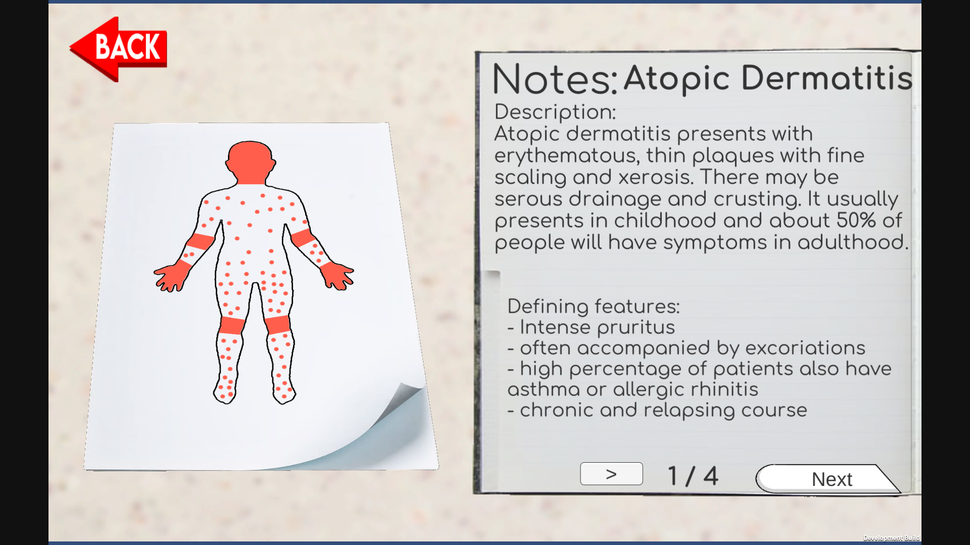
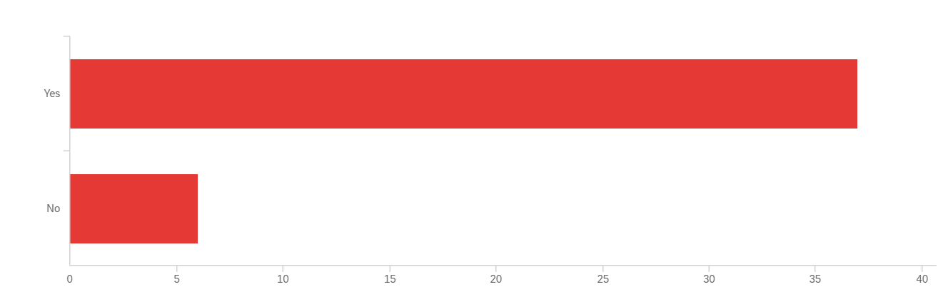
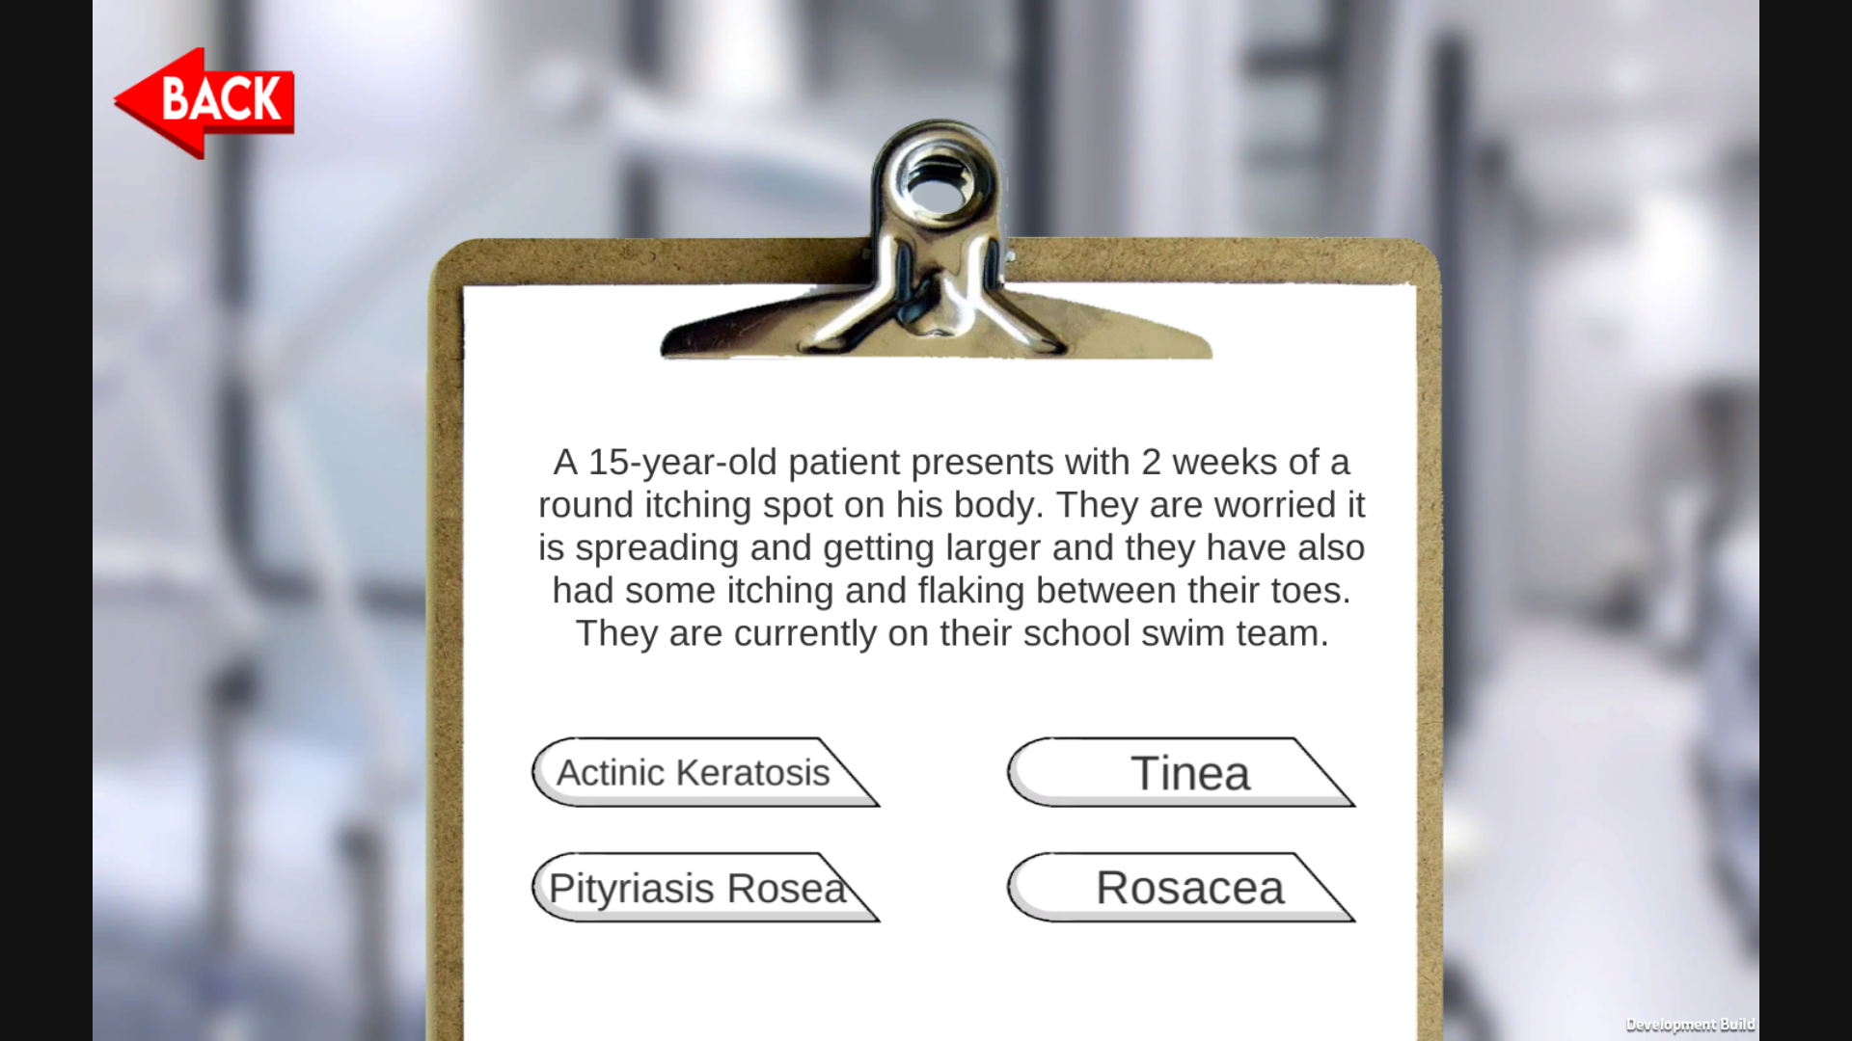
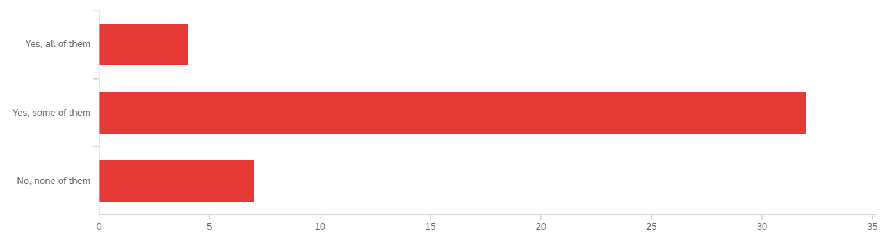
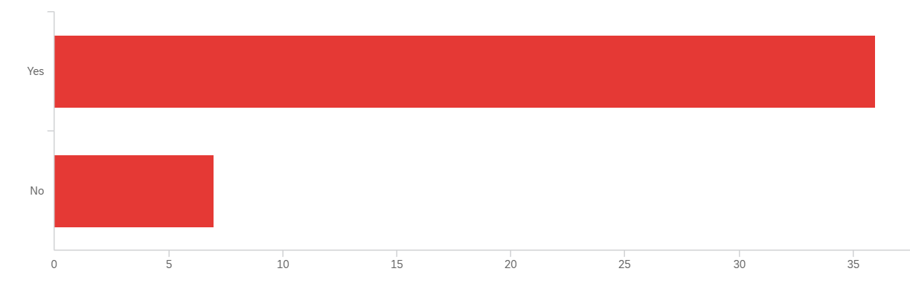
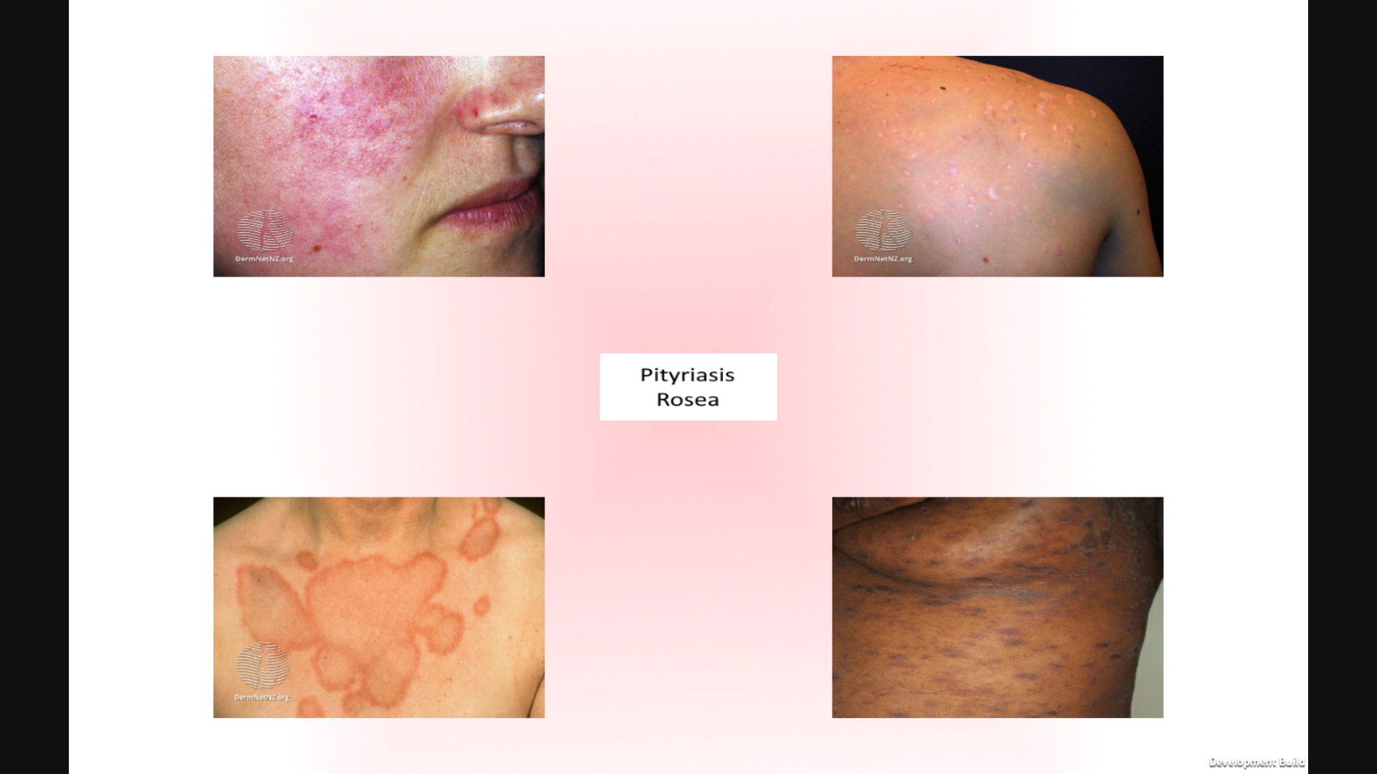



Symptom Selection: A Dermatology Education Game
$Eliessa Bell, Elena Bertozzi, PhD$, $Christopher Humphrey,$
$$Frank H Netter MD School of Medicine at Quinnipiac University$$
Try Symptom Selection for yourself!
Introduction
Results
Results
Skin complaints are among the top ten most common reasons for visits to primary care physicians reported by clinicians and patients. Most medical schools require fewer than 10 hours of dermatology education leaving many students feeling unprepared to identify dermatologic disease during their clinical years$^{1}$.
Additionally, there is a significant disparity in training when it comes to identifying pathology in skin of color. In one study, 47% of dermatologists felt that their training was inadequate to diagnose skin disease in skin of color$^{2}$.
After initial development was completed, the game was distributed to medical students for beta-testing which identified areas of improvement. Following refinement, the game was then published for online use and distributed to students at Quinnipiac University with a post-play survey.
n = 43, M1-M4 students
Did playing this game increase your confidence in your ability to identify common rashes in clinical scenarios?
Yes: 86%
No: 14%
Have you ever seen the rashes in this game in your clinical experiences?
No: 9%
Yes, some: 74%
Yes, all: 16%
Would you find this game preferable to other study methods? (e.g. flashcards, lectures, etc.)
Yes: 84%
No: 16%
Purpose
The purpose of this study is to determine if an online game can improve medical student confidence in identifying dermatologic conditions and to assess the utility of a dermatology education game.
Methodology
Development of Symptom Selection began humbly with a paper prototype of a matching game. A subsequent review of literature on the use of games in medical education aided in establishing a pedagogical strategy for the next evolution of Symptom Selection, a strategy based on behaviorism and cognitivism. According to these strategies, this game prioritizes knowledge transmission through quizzes and simulations focused on memory and skill development through repetition$^{3}$. After partnering with a game developer, the project was moved to a digital platform and expanded to a series of minigames allowing the player to practice identifying visual signs of disease and symptomatology in vignettes using these strategies.
To build the content of the game, six diseases were chosen: tinea infections, atopic dermatitis, rosacea, pityriasis rosea, acne vulgaris, and actinic keratosis. These were chosen from AAFP competency guidelines in dermatology. Illness scripts highlighting the major characteristics of each disease were developed alongside curated sets of images depicting each condition across the spectrum of skin tone and in varying presentations of disease.
Conclusion
Medical education games can influence student perception and confidence in clinical skills.
Students show interest and engagement in a video game learning tool for dermatology subjects.
Future:
The next step for this project is to expand the content and assess efficacy of the game. If the game exhibits effectiveness, it could be integrated into the curriculum as a learning tool for dermatology.
Special thanks to VisualDx and DermNetNZ for contributing the images which make this game possible.
References:
1. Patrick E. McCleskey, Robert T. Gilson, Richard L. DeVillez, Medical Student Core Curriculum in Dermatology Survey, Journal of the American Academy of Dermatology, Volume 61, Issue 1, 2009, Pages 30-35.e4, ISSN 0190-9622, 2.
2. Lester, J., Taylor, S., & Chren, M. (2019). Under‐representation of skin of colour in dermatology images: Not just an educational issue. British Journal of Dermatology, 180(6), 1521-1522.
3. Gorbanev, I., Agudelo-Londoño, S., González, R. A., Cortes, A., Pomares, A., Delgadillo, V., Yepes, F. J., & Muñoz, Ó. (2018). A systematic review of serious games in medical education: quality of evidence and pedagogical strategy. Medical education online, 23(1), 1438718.
Notes:
include what you learned in the process
talk about the process
how to select and synthesize info
Using interactive media for med ed
how do people learn best
publish to website
In the process of developing this game, I came to greatly value the educational resources we often take for granted. The integration of academic content, technology, learning pedagogy, and entertainment is a complicated balancing act which is challenging to approach.
The process of developing this game started with setting a realistic scope. An overly ambitious project would have quickly succumbed to disorganization and a lack of direction. Even though there are dozens of diseases I would have liked to include in the content of this game, piloting a game with six diseases made this much more manageable as a developer. Maintaining a narrow and achievable scope is what allowed this project to come to fruition.
Purpose:
This game should help medical students prepare for identifying dermatologic disease in clinical scenarios. Additional objectives include utilizing a diverse set of images for students to learn from, including diseases which are most encountered in primary care settings, and including teaching points addressing the spectrum of skin tone.

